Slide 1
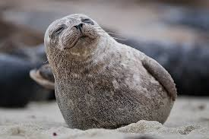
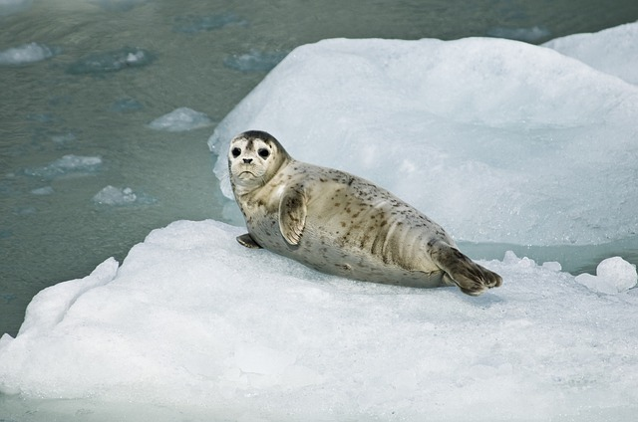
FLIR Data analysis of the relationship between ice temperature and body temperature of Harbor Seals in John Hopkins Inlet, Alaska
By: Emily Pendergrass

Slide 2
Why Do We Care?
Very little information on these animals
Very little is know about their habitat preferences
Global warming is destroying ice related habitats
Notes:
It was just recently discovered that the majority of seals tend to prefer sea ice habitat.
The US Geological Survey predicts that there will be no sea ice left on the planet after the year 2050.

Slide 3
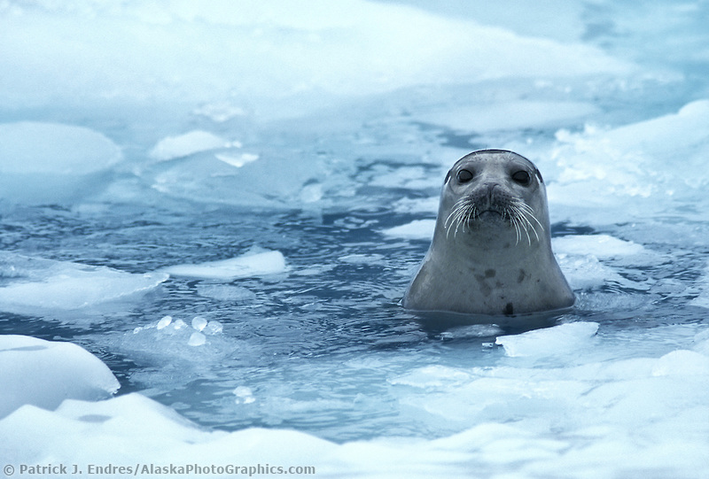
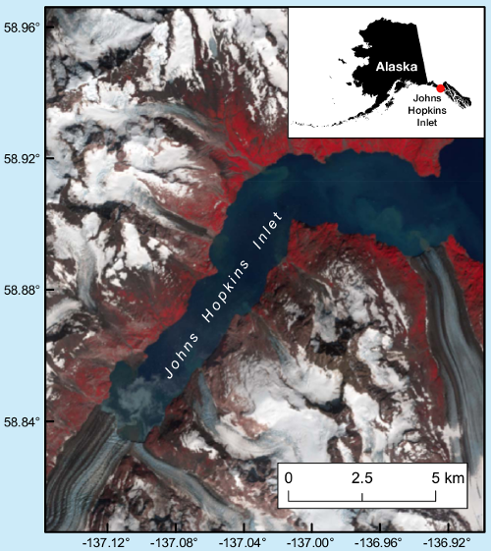
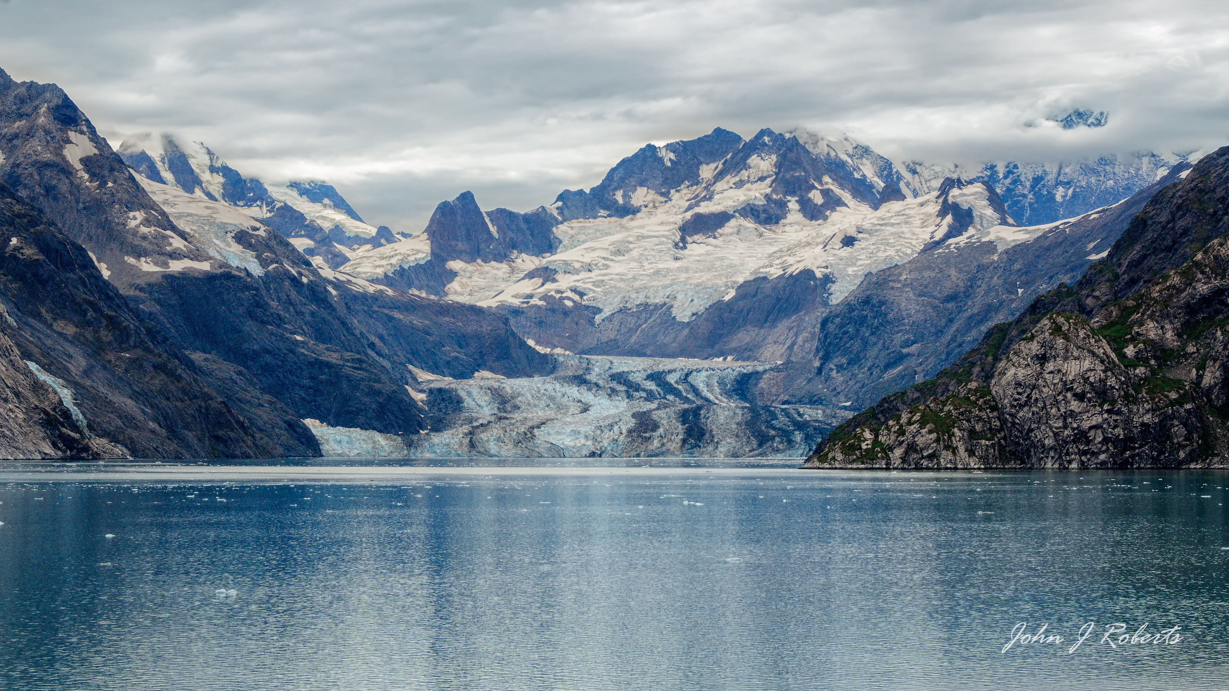
Study Area
Map source: http://harborseals.alaska.edu/contacts.html

Slide 4
Work Flow Chart
Download FLIR data
Identify images with harbor seals present
Drew thermal temperature lines on each individual adult seal on ice
Exported and statistically processed thermal lines from seal data
Separated adult seals on ice from pups and swimming seals

Slide 5
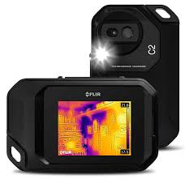

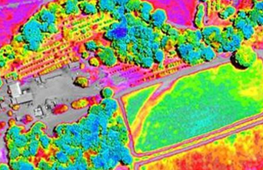
FLIR Data
Notes:
Plane flies over your study area and records infrared images in video form, then you chose which clips of this data you want to use and analyze it for specific spectral signatures.

Slide 6
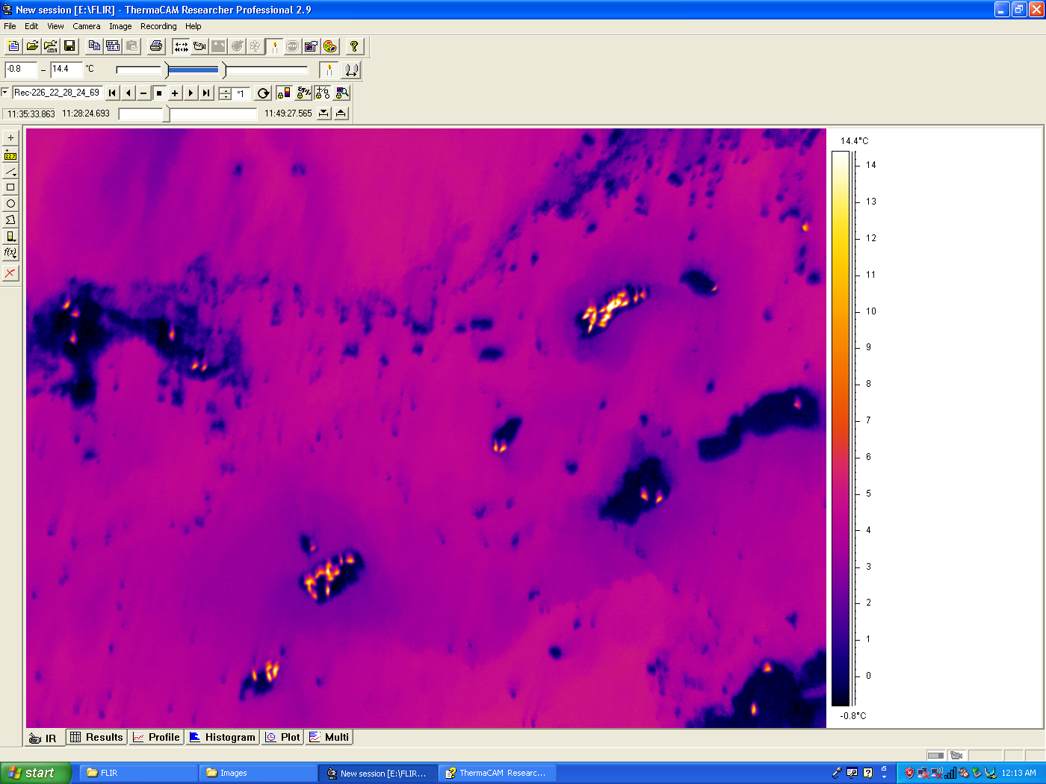
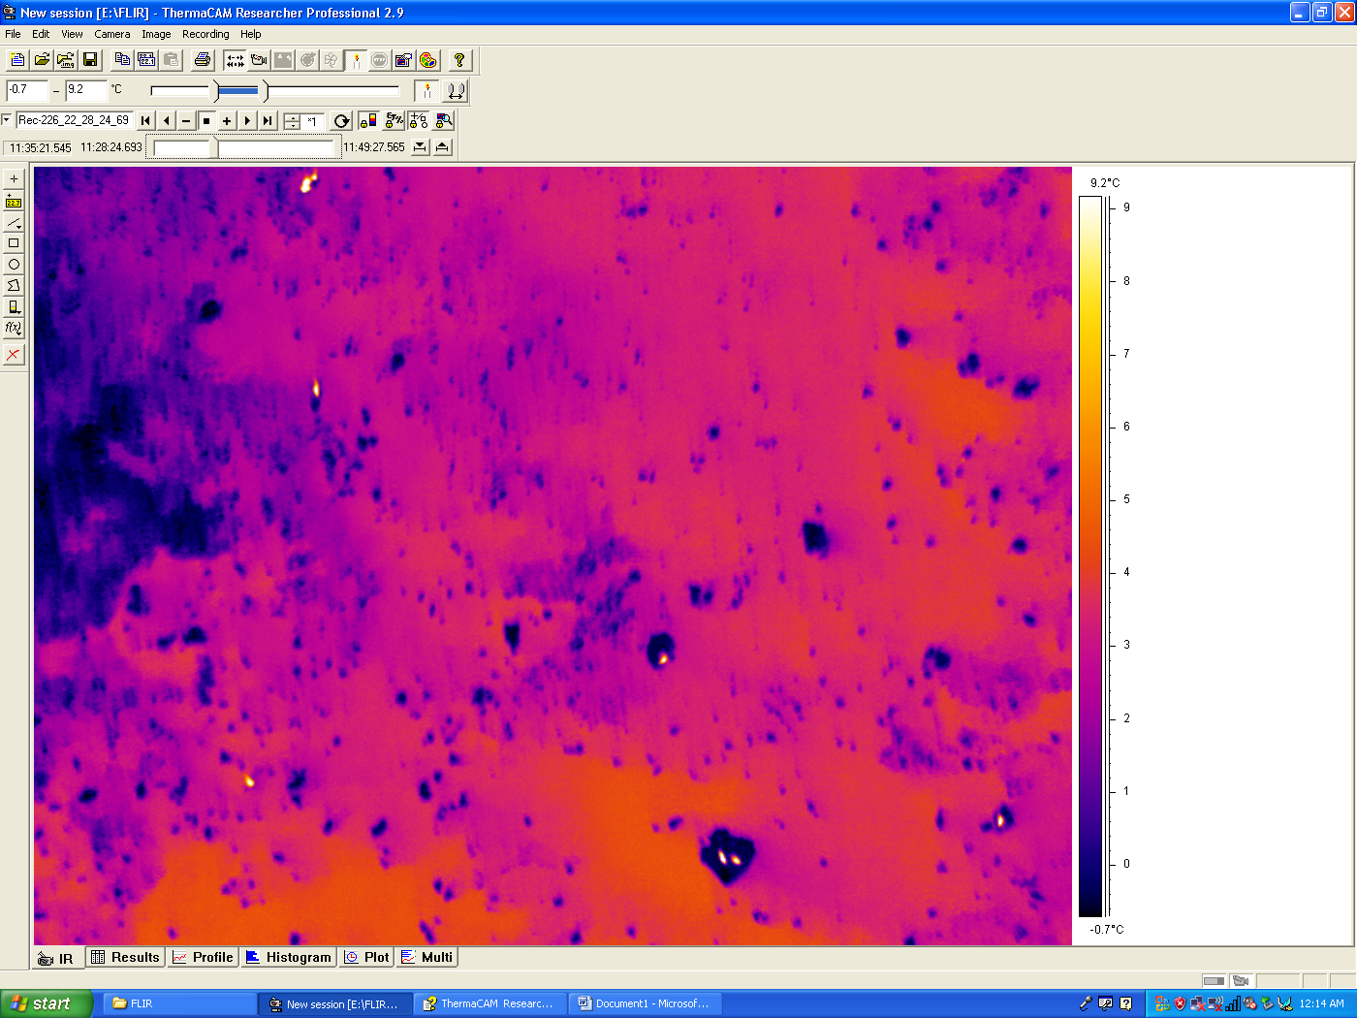
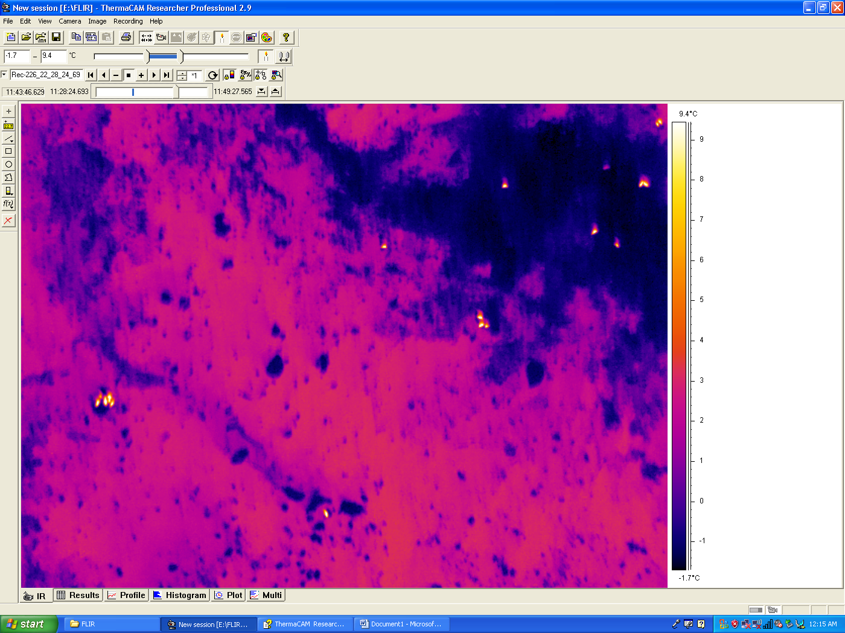
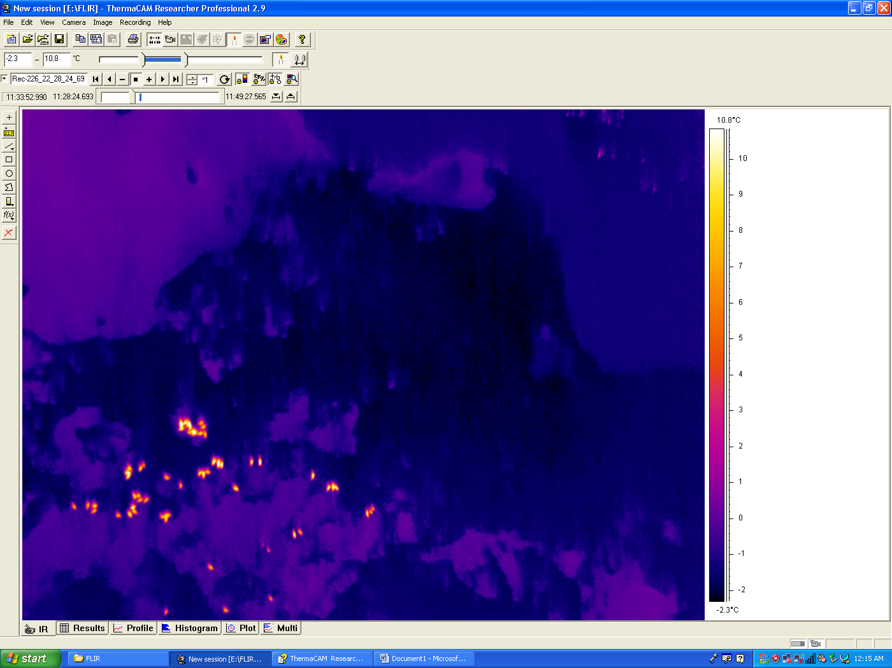
Thermal Harbor Seal Images
Image 1
Image 2
Image 3
Image 4

Slide 7
Infrared Harbor Seal Images
Image 1

Slide 8
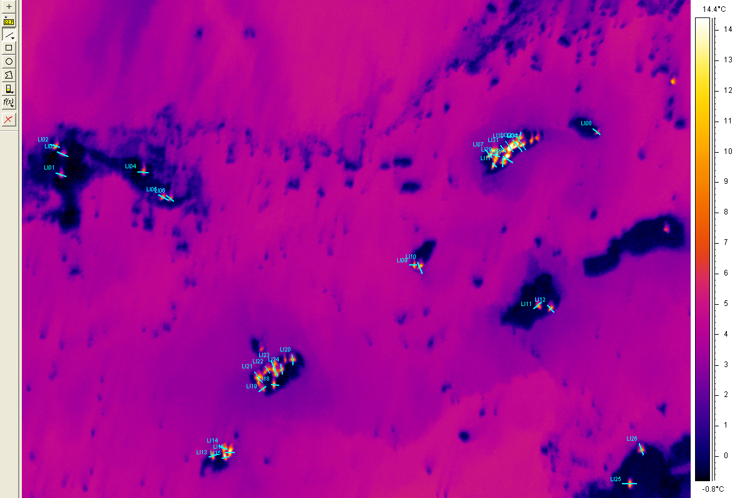
Drawing Thermal Lines

Slide 9
Data Analysis

Slide 10
Data Results

Slide 11
Conclusion
This data shows that there is a threshold (at about 5 degrees Celsius) between the body temperatures of the seals and the ice temperature of their habitat.
This could be used in the future to separate out all of the seals from the data via supervised classification of FLIR temperatures.

Slide 12
Future Questions
Correlation between measured external body temperature and actual seal mass
Does sea ice have a specific size to temperature ratio or threshold

Slide 13
References
References
http://harborseals.alaska.edu/contacts.html
Quantifying the Availability of Tidewater Glacial Ice as Habitat for Harbor Seals in a Tidewater Glacial Fjord in Alaska Using Object-Based Image Analysis of Airborne Visible Imagery via: http://adsabs.harvard.edu/abs/2013AGUFMGC23D0976P, Volume: 2013AGUFMGC23D0976P
http://www.nps.gov/glba/learn/nature/seal.htm
JANSEN, J. K., P. L. BOVENG, J. M. Ver HOEF, S. P. DAHLE, and J. L. BENGTSON. 2015. Natural and human effects on harbor seal abundance and spatial distribution in an Alaskan glacial fjord. Mar. Mammal Sci. 31:66-89. (.pdf, 800 KB).
Duglas, D. (2010). Arctic Sea Ice Decline: Projected Changes in Timing and Extent of Sea Ice in the Bearing and Chukchi Sea. Retrieved November 28, 2015, from http://pubs.usgs.gov/of/2010/1176/pdf/ofr20101176.pdf

Slide 14
Acknowledgments
I would like to thank Dr. Prakash and her husband for providing the data and Chris Waigl for a crash course in FLIR data processing.

Slide 15
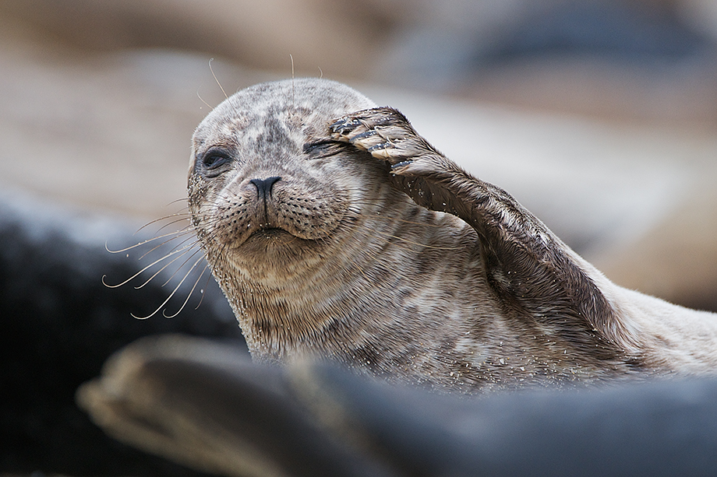
Questions

